Slide 1


FRONT PAGE
Thao Truong Art
Home
About
Collections
Contact
FAQs
Australian Birds
Female Figures
Click on this box then it’ll take to slide 3
Pet Portraits
Fluid Arts

Slide 2
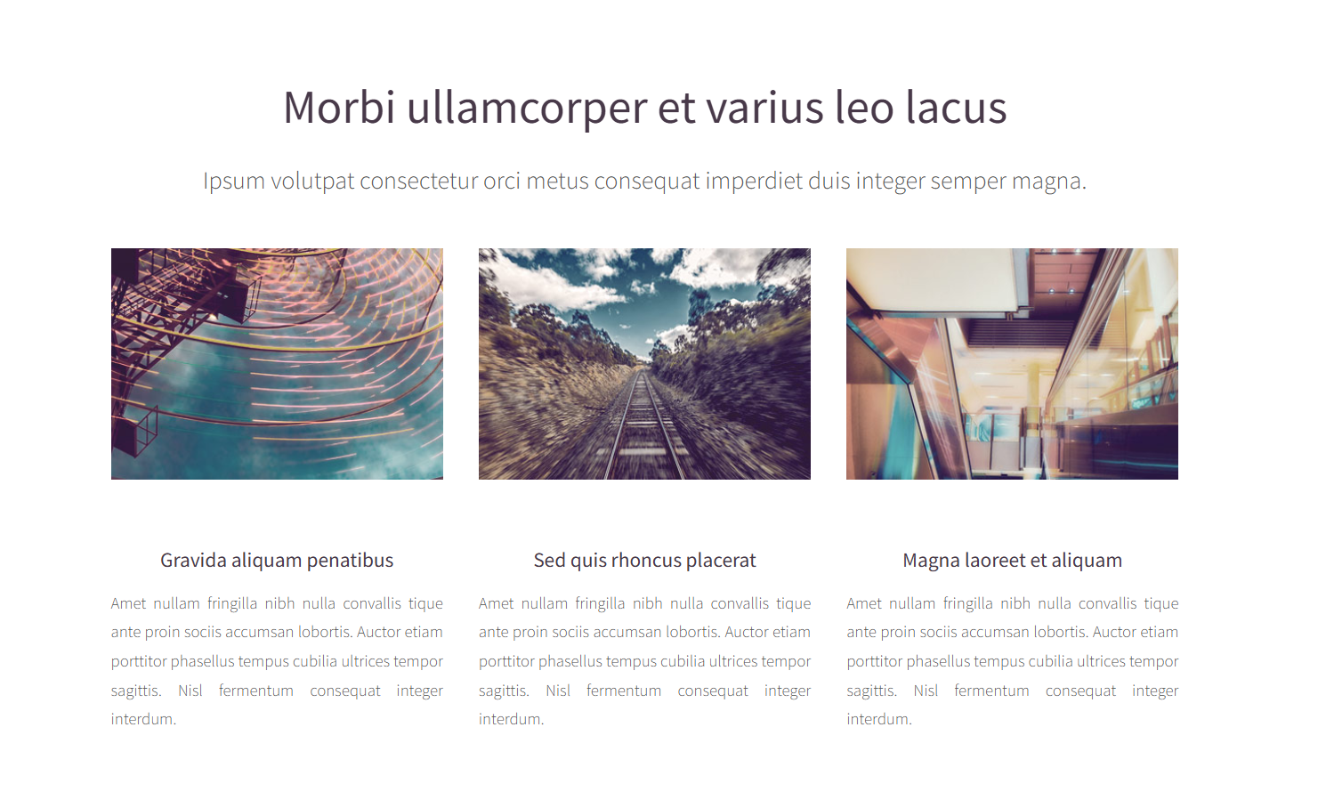
Collections
Click on this box then it’ll take to slide 3
Australian Birds
Female Figures
Pet Portraits
Fluid Art

Slide 3
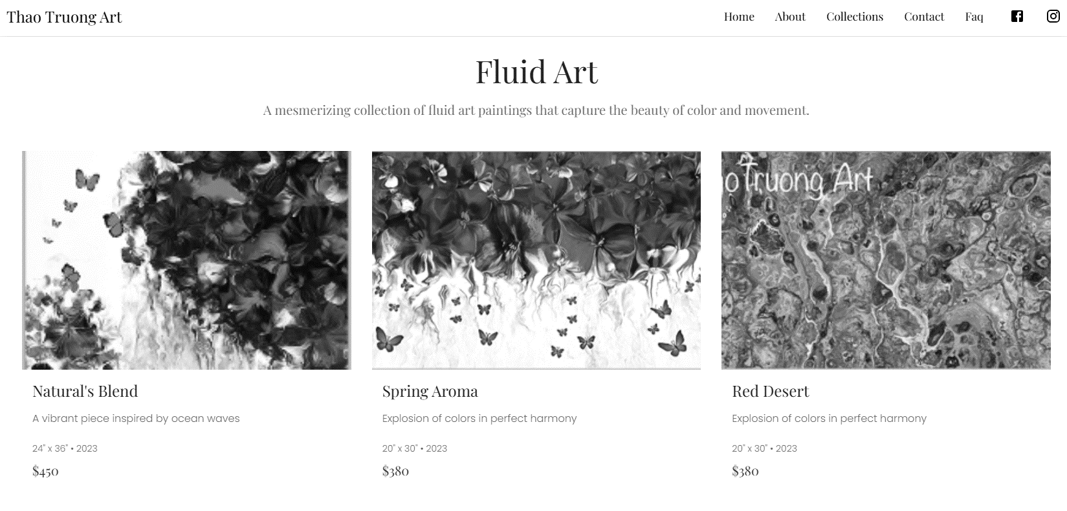
Same layout with Fluid Art for Women Figures

Slide 4
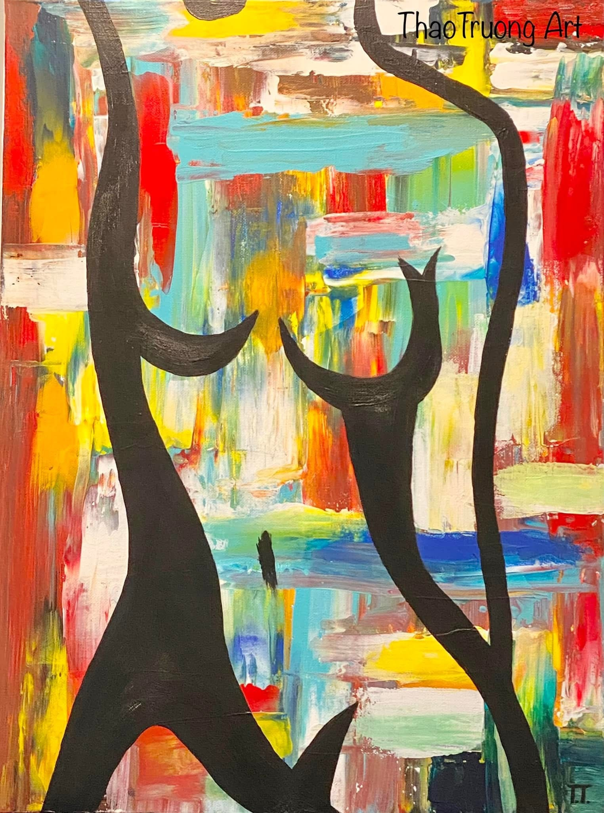
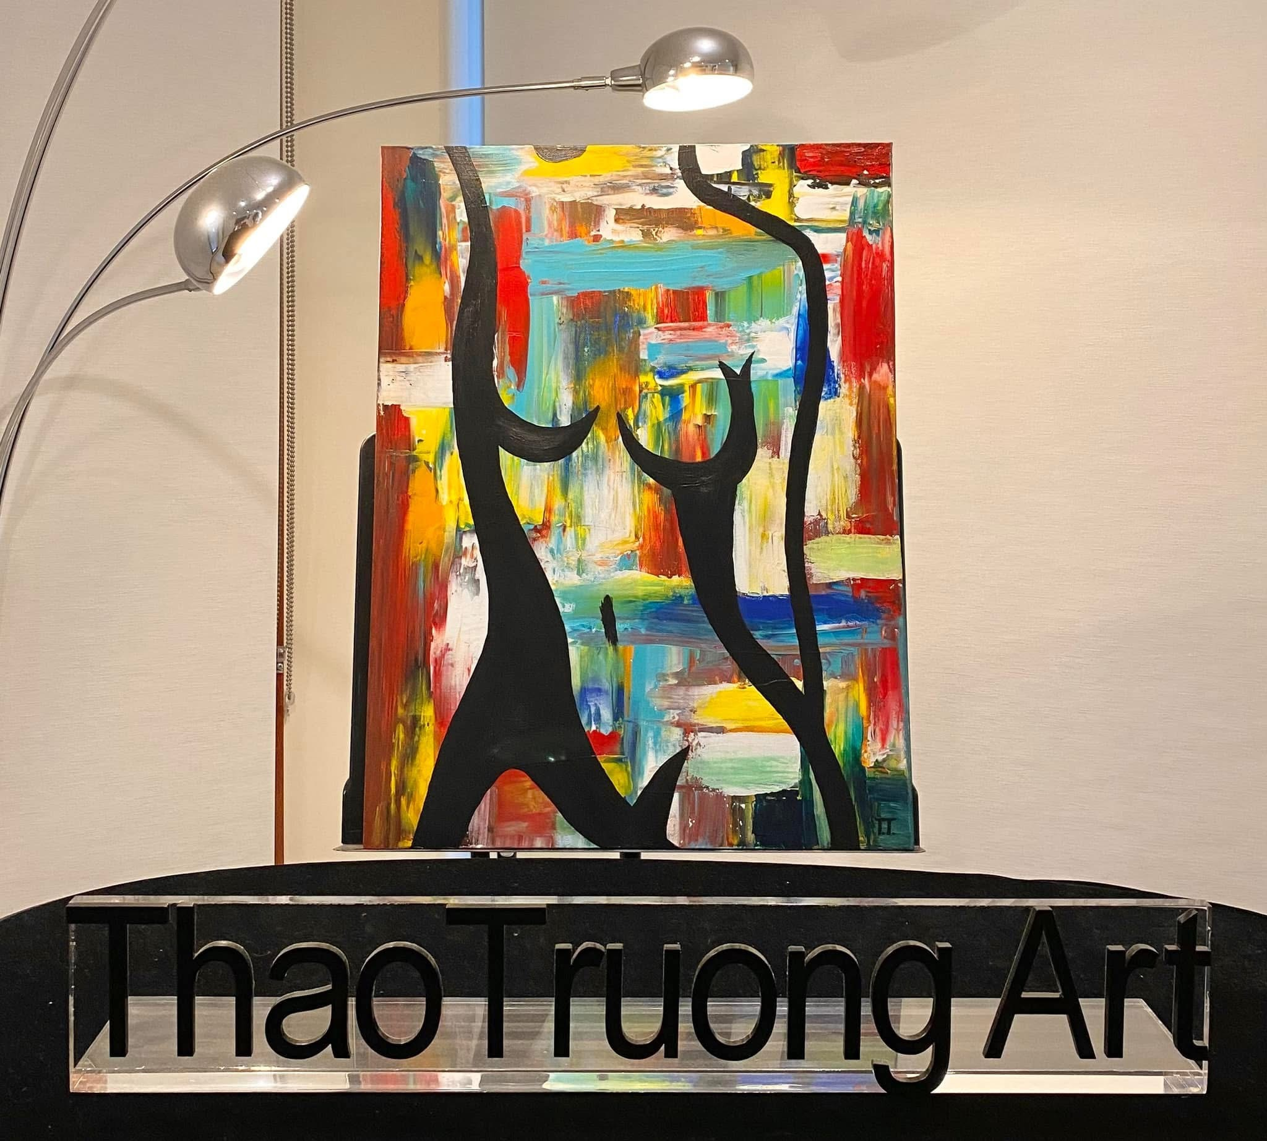
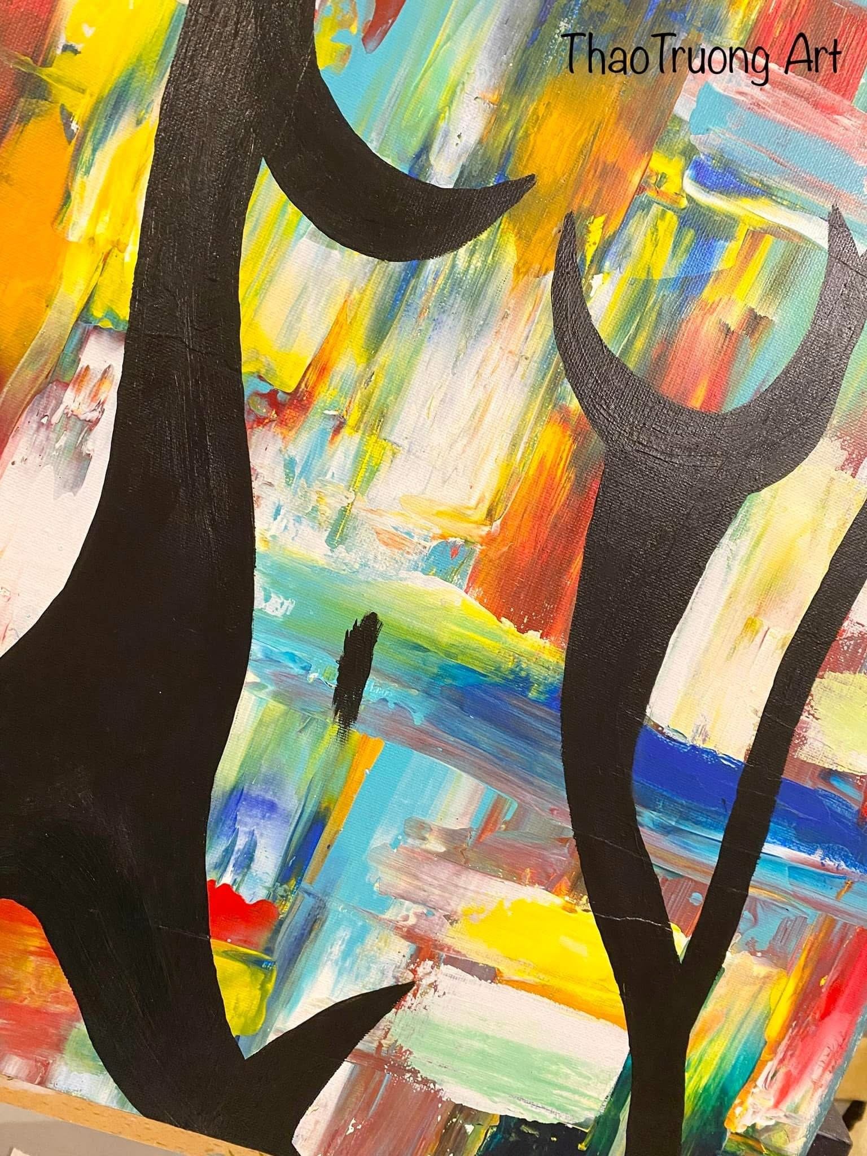
Women Figure #1– Acrylic on stretched canvas
Size: 60x50x3cm
Gloss varnish
AU$420.00
Photos for this page are #1, #1a, #1b
Add all the text description for this art piece as above
ThaoTruong Art - Joyful Art Getaway
*For display purpose only and may not be to scale

Slide 5
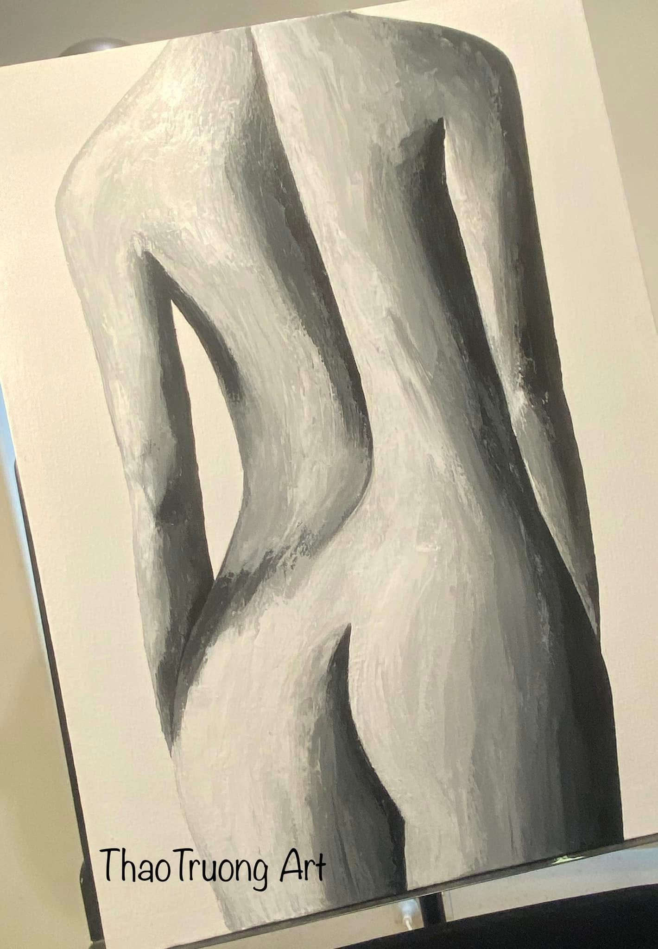
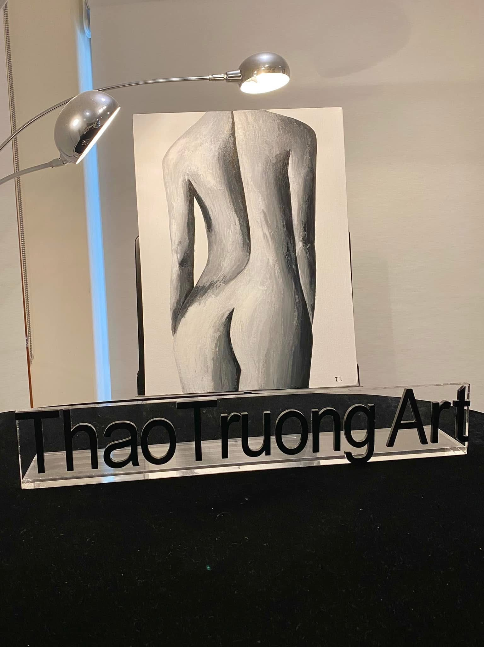
Women Figure #2– Acrylic on stretched canvas
Size: 60x50x3cm
Gloss varnish
AU$420.00
Add all the text description for this art piece as above
Photos for this page are #2, #2a
ThaoTruong Art - Joyful Art Getaway
*For display purpose only and may not be to scale

Slide 6
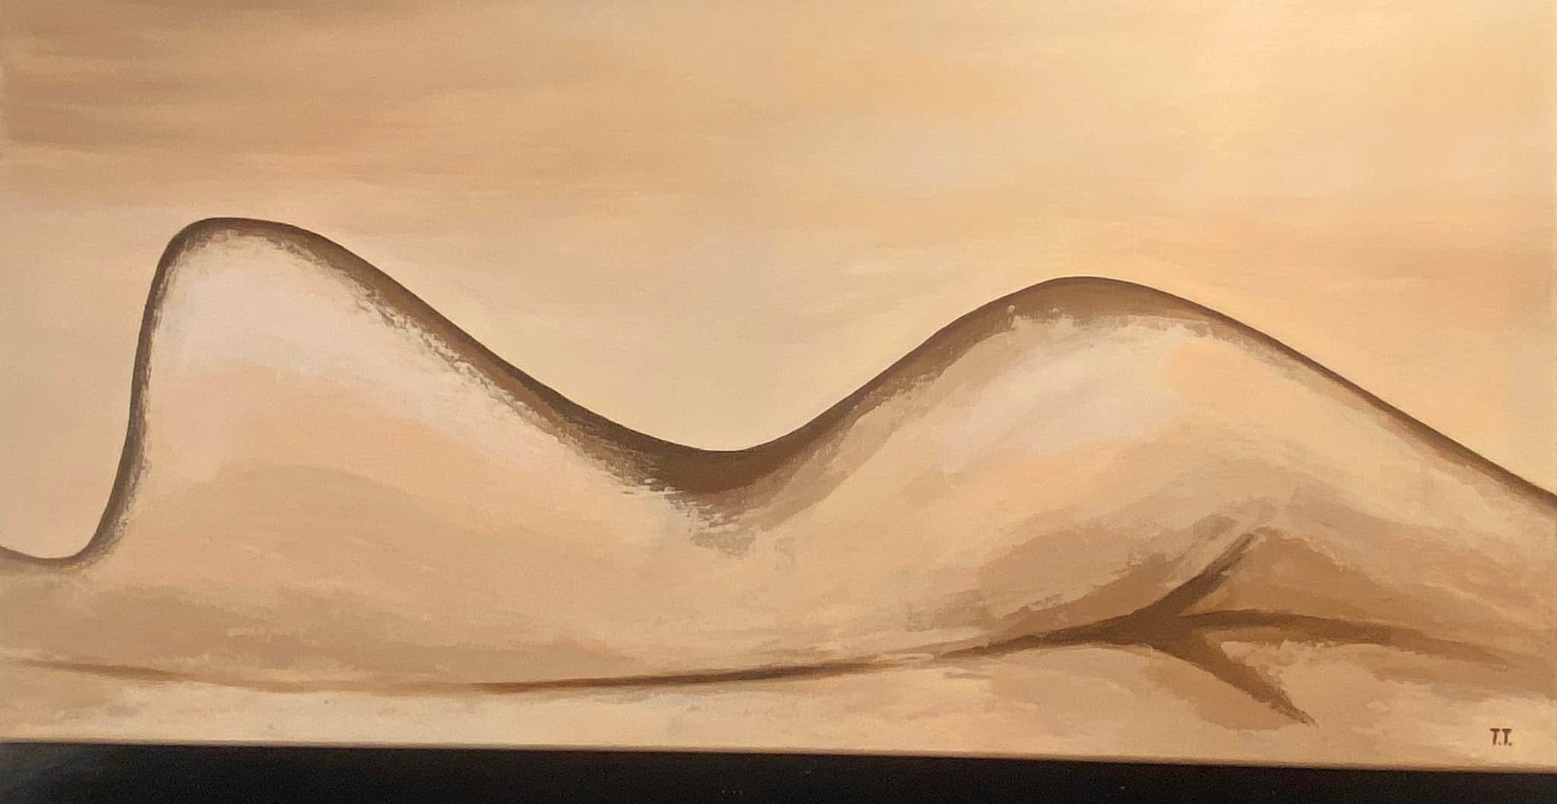
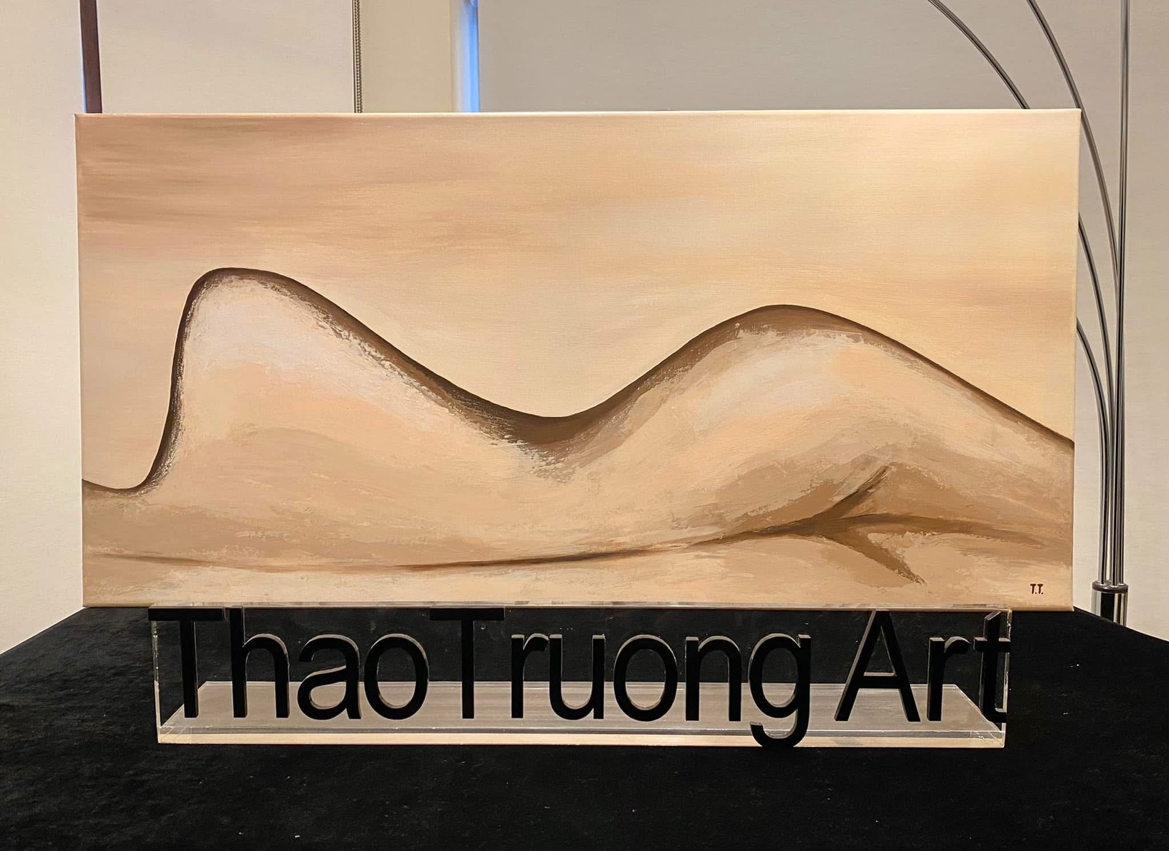
Women Figure #3– Acrylic on stretched canvas
Size: 50x100x1.5cm
Gloss varnish
AU$420.00
Add all the text description for this art piece as above
Photos for this page are #3, #3a
ThaoTruong Art - Joyful Art Getaway
*For display purpose only and may not be to scale

Slide 7
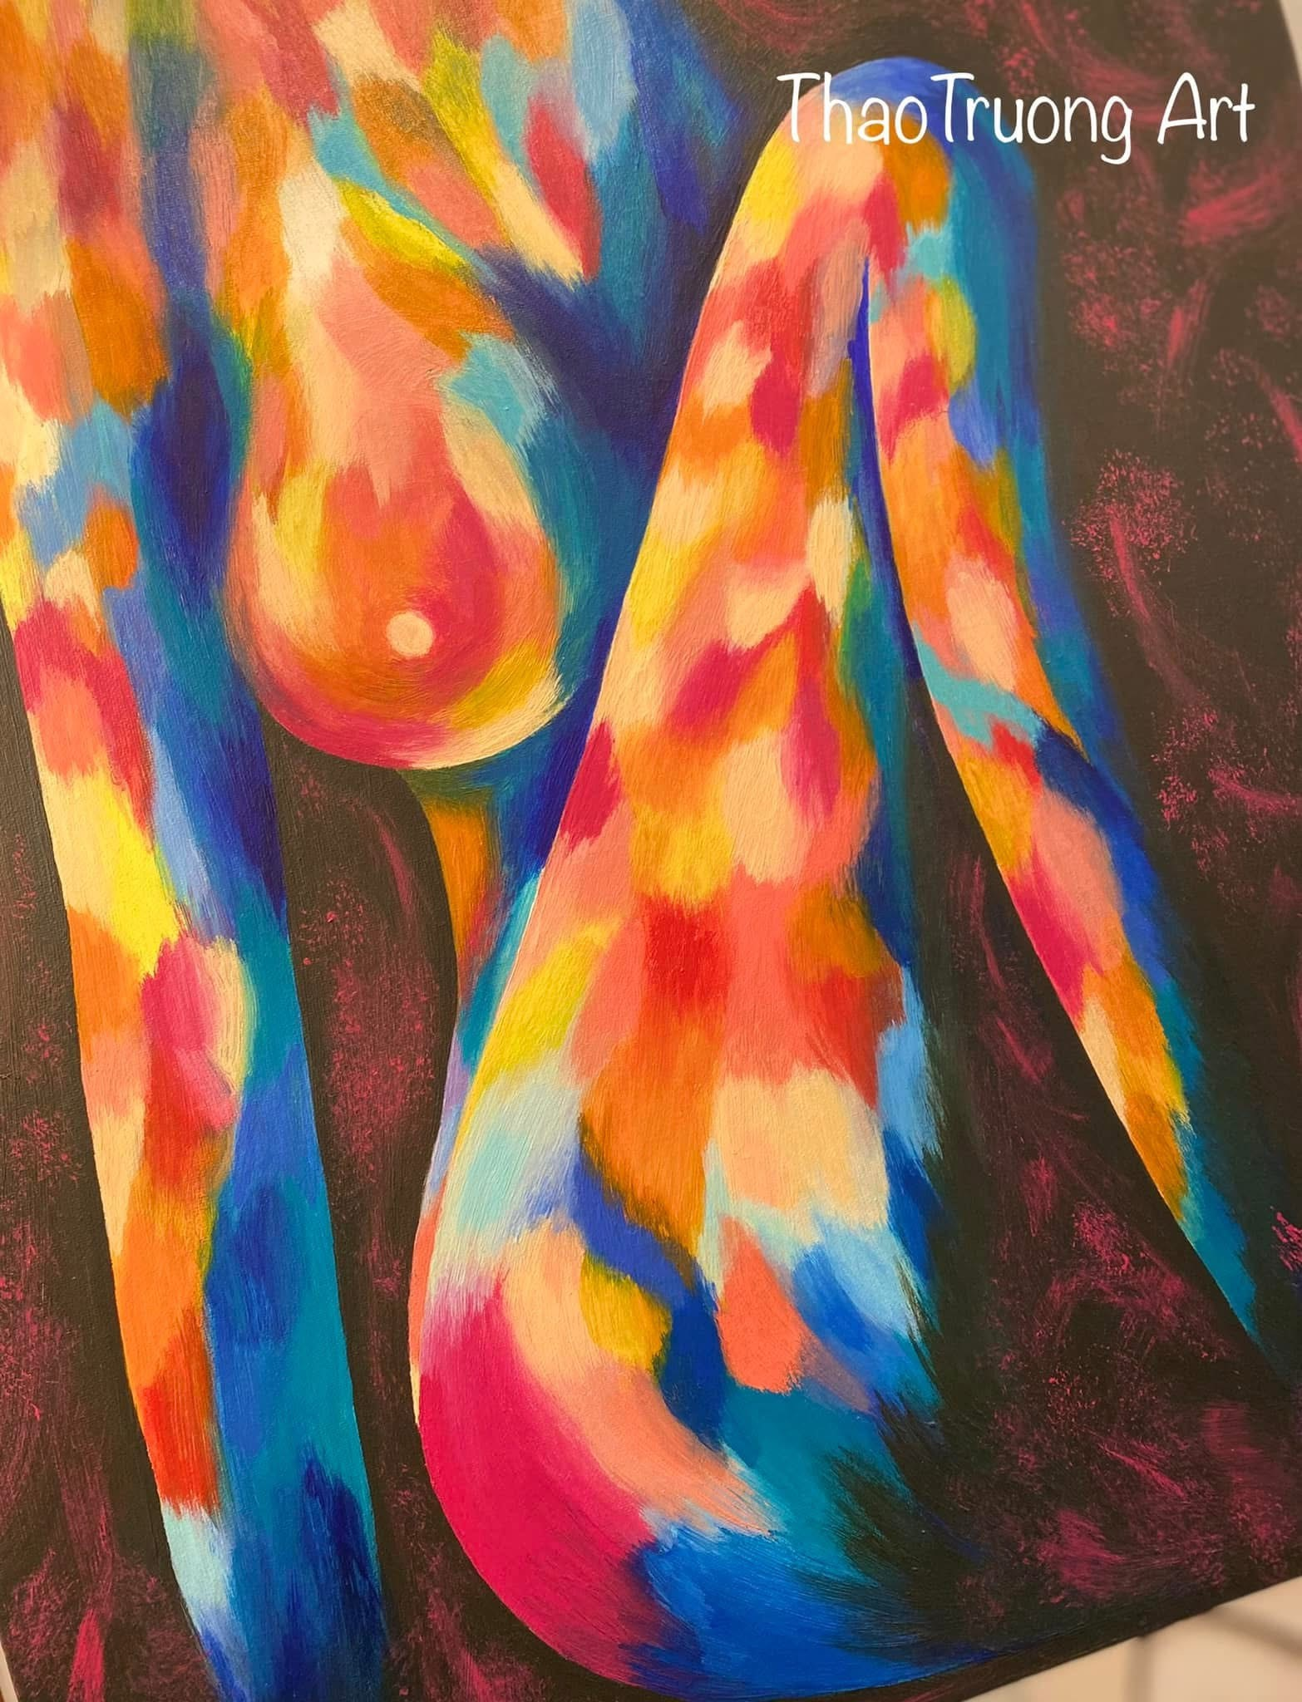
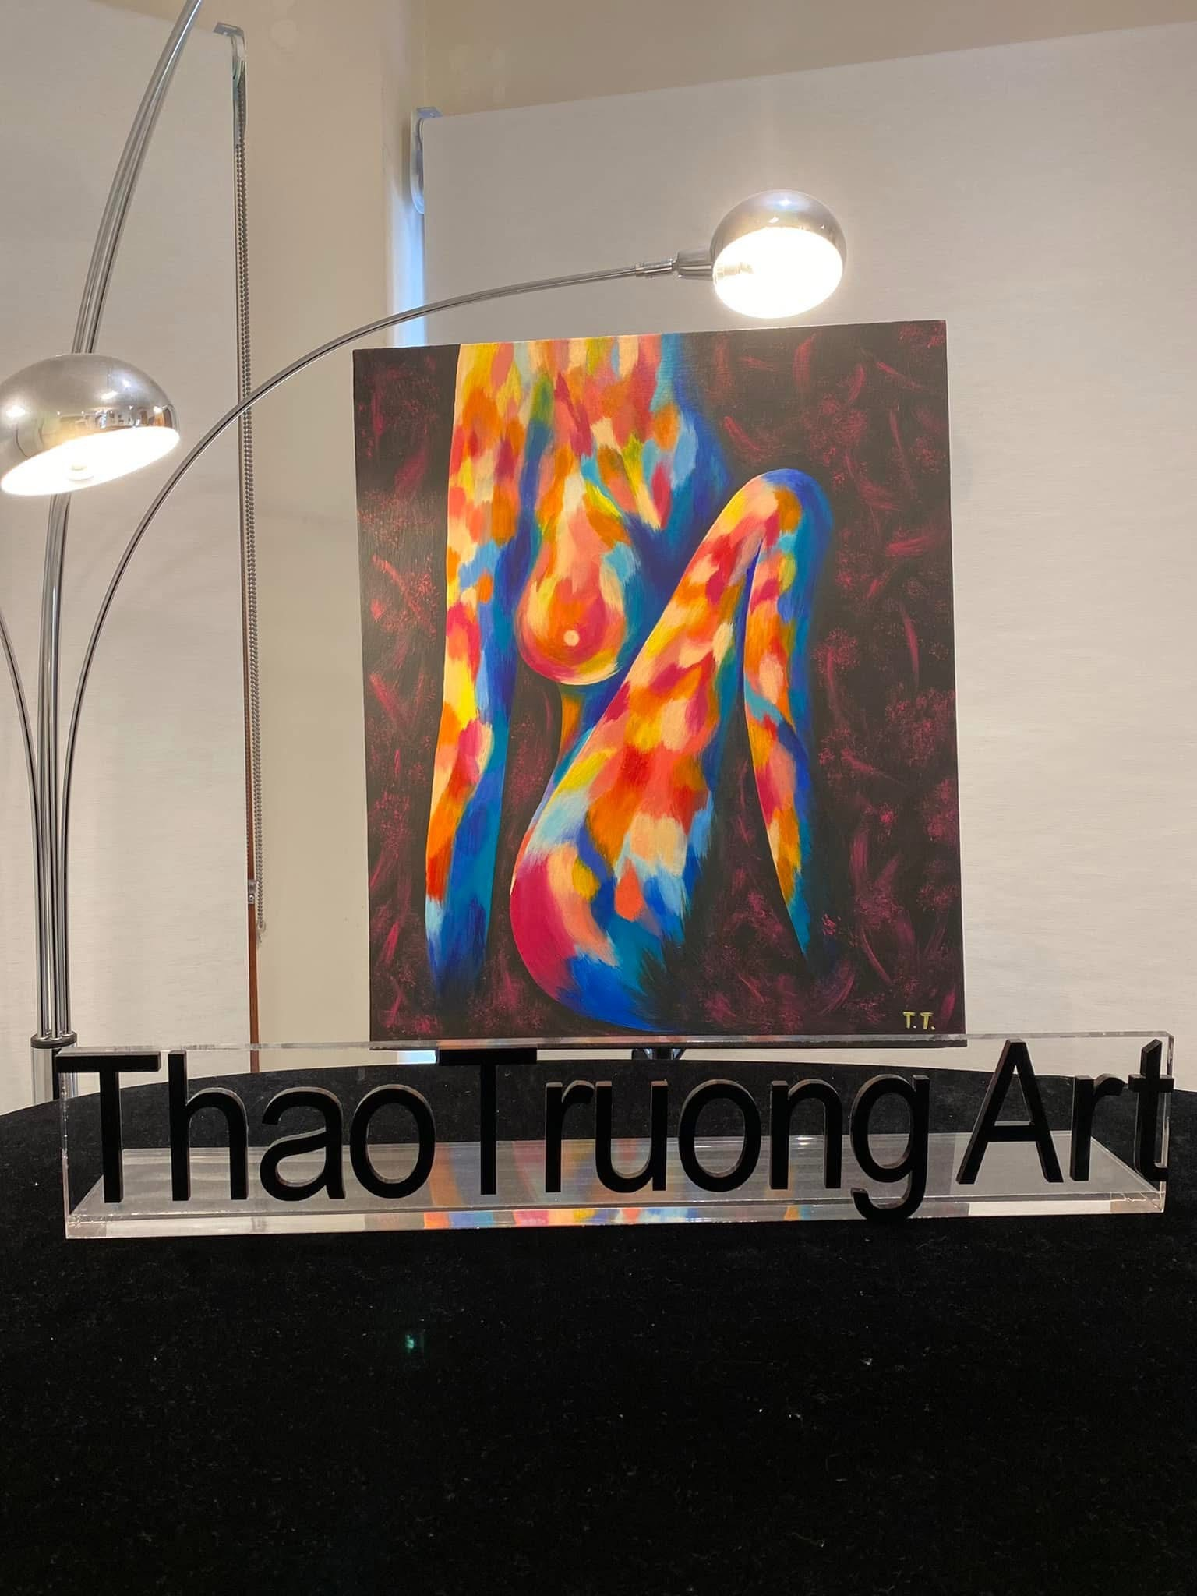
Women Figure #4– Acrylic on stretched canvas
Size: 50x60x3cm
Gloss varnish
AU$420.00
Add all the text description for this art piece as above
Photos for this page are #4, #4a
ThaoTruong Art - Joyful Art Getaway
*For display purpose only and may not be to scale

Slide 8
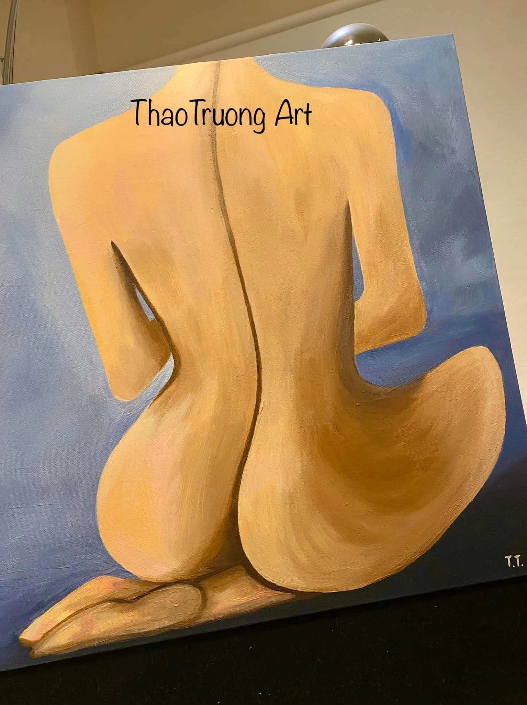
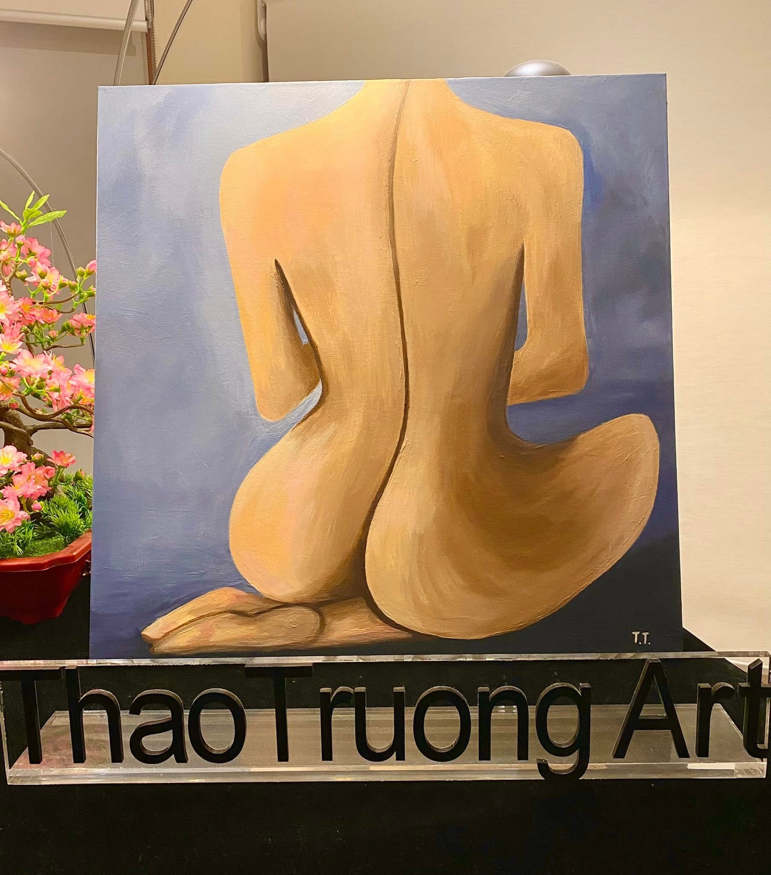
Women Figure #5– Acrylic on stretched canvas
Size: 60x60x3cm
Gloss varnish
AU$420.00
Add all the text description for this art piece as above
Photos for this page are #5, #5a
ThaoTruong Art - Joyful Art Getaway
*For display purpose only and may not be to scale

Slide 9
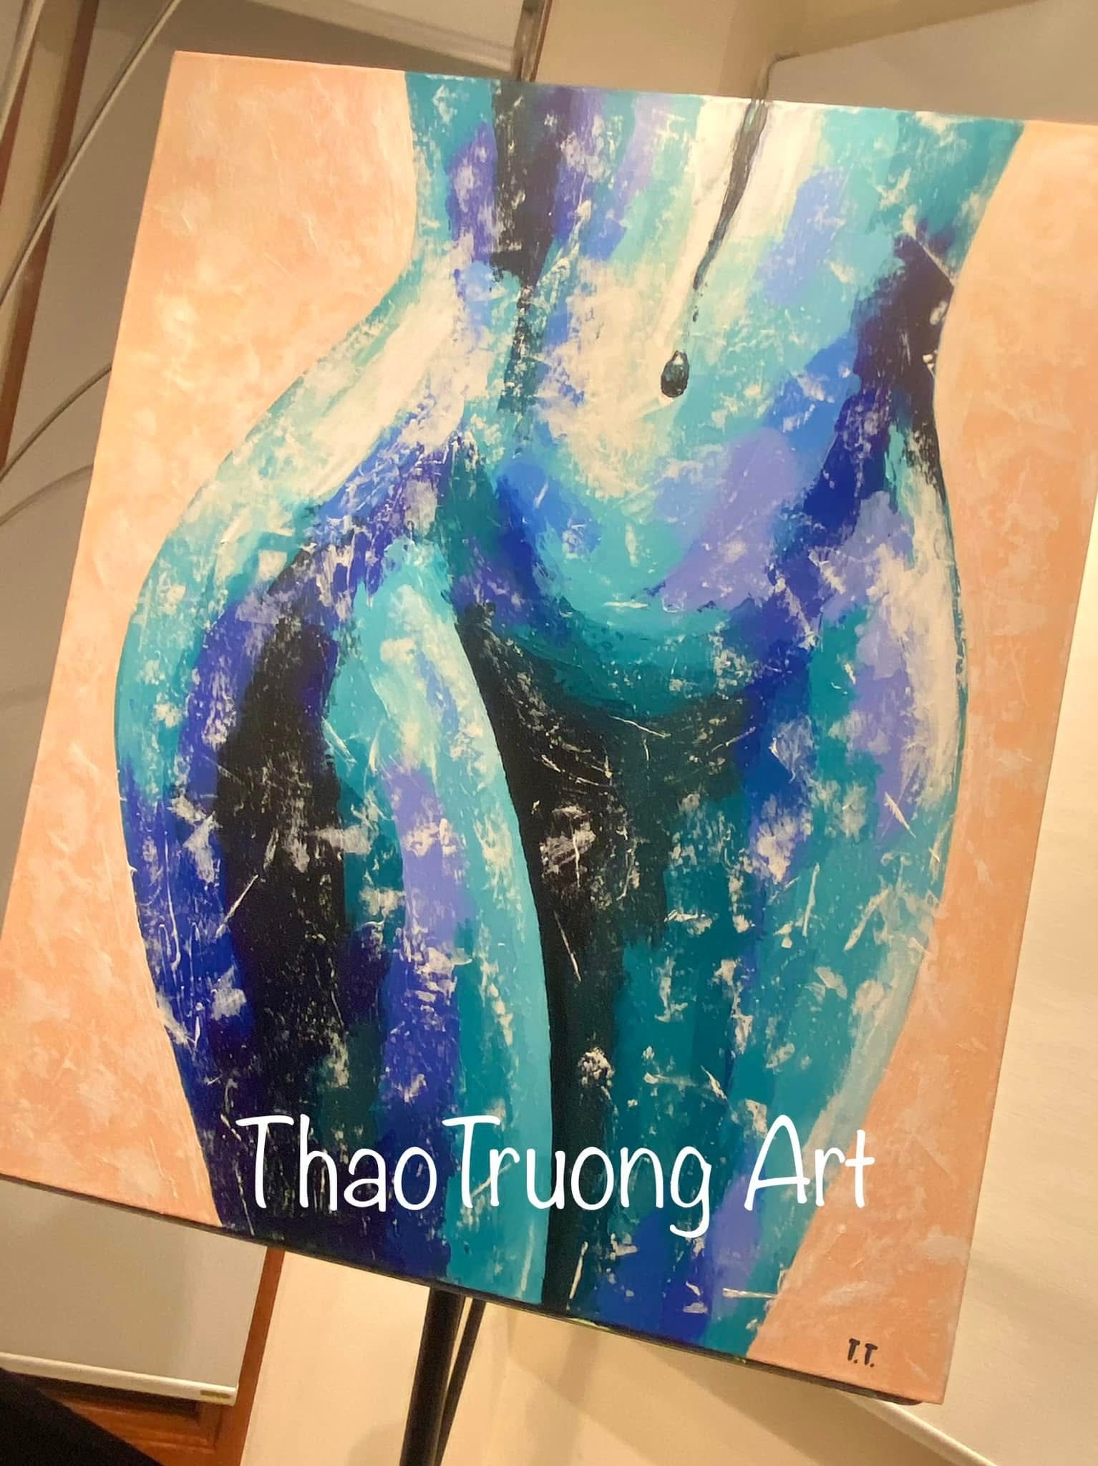
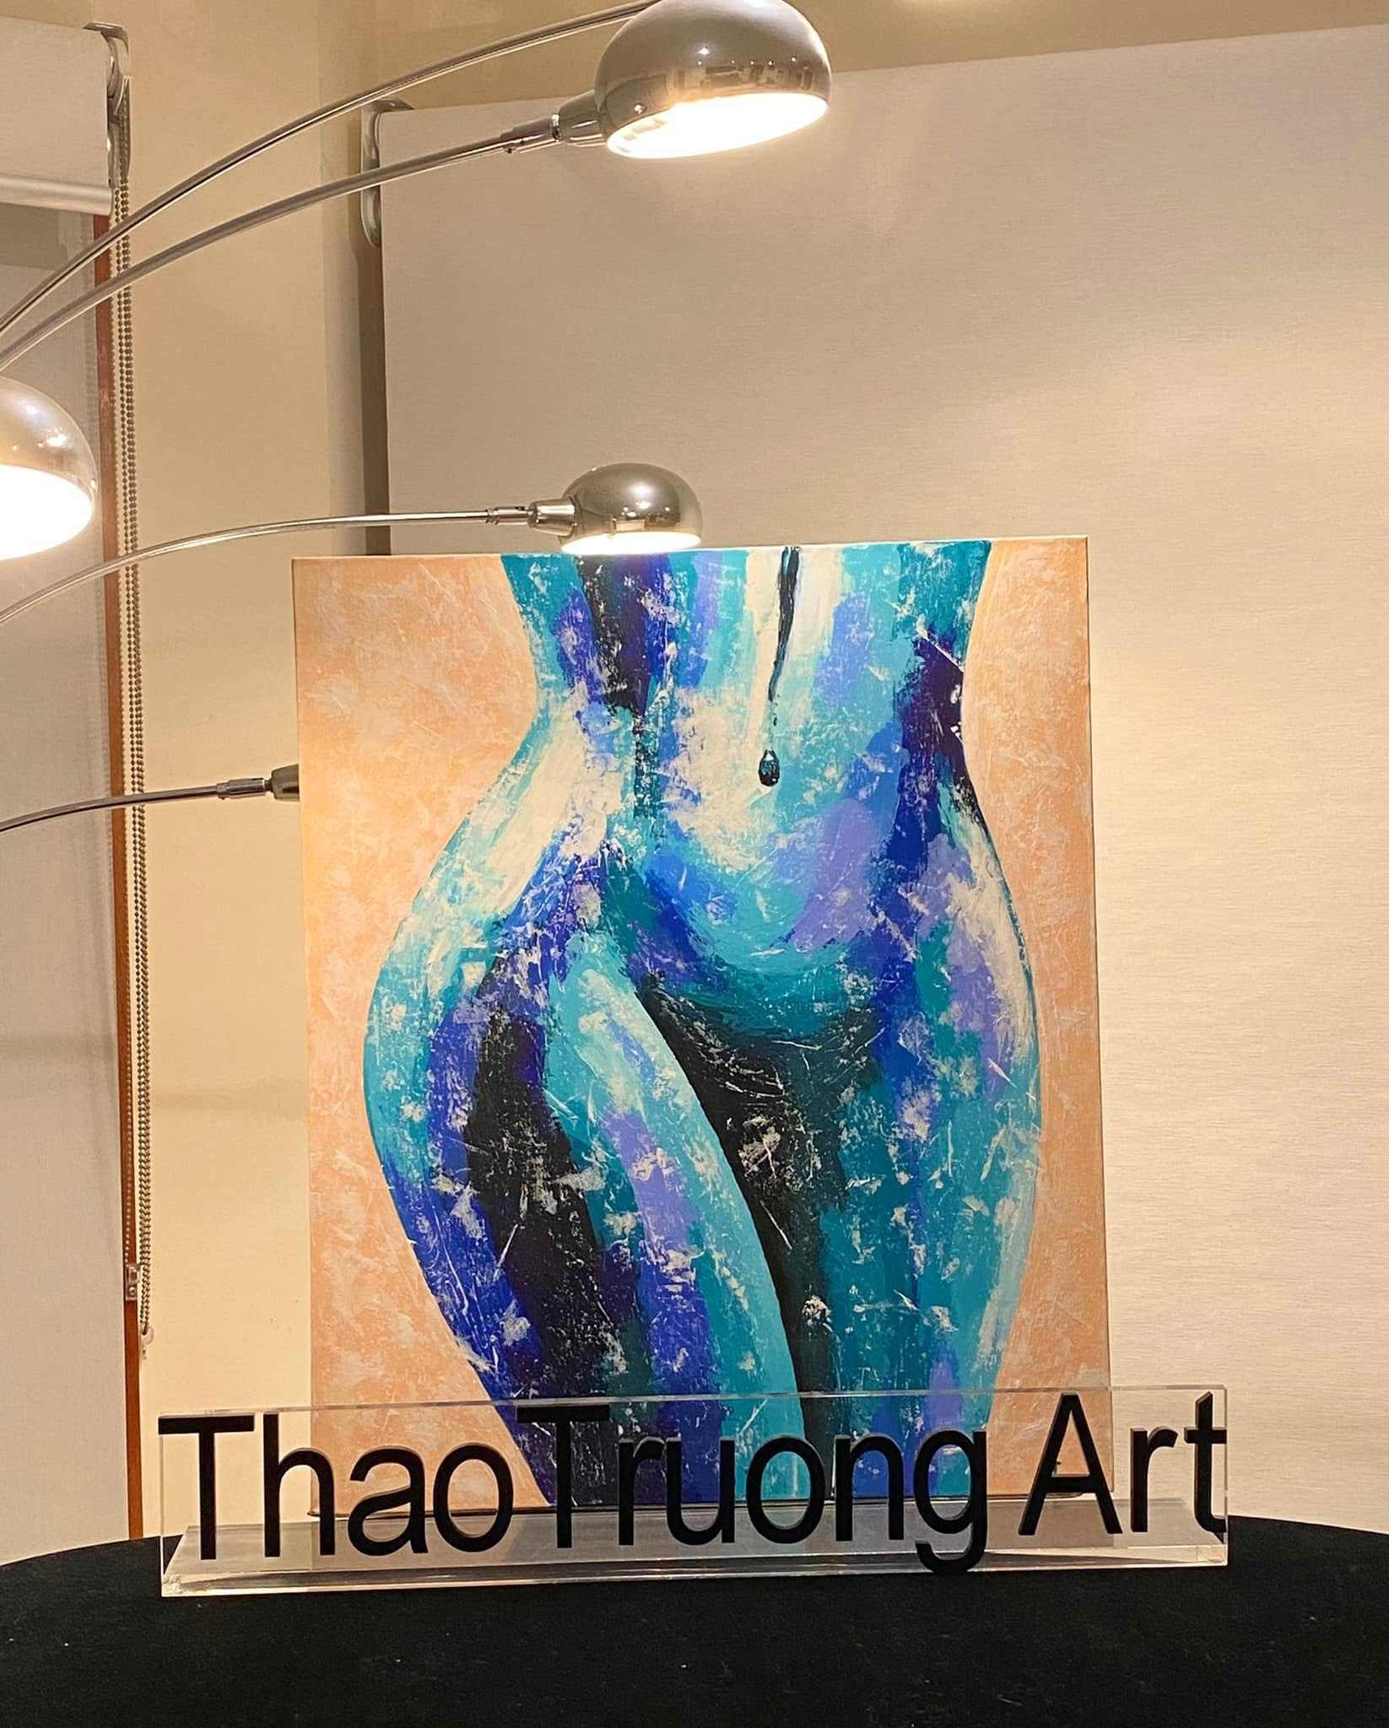
Women Figure #6– Acrylic on stretched canvas
Size: 50x60x3cm
Gloss varnish
AU$420.00
Add all the text description for this art piece as above
Photos for this page are #6, #6a
ThaoTruong Art - Joyful Art Getaway
*For display purpose only and may not be to scale

Slide 10
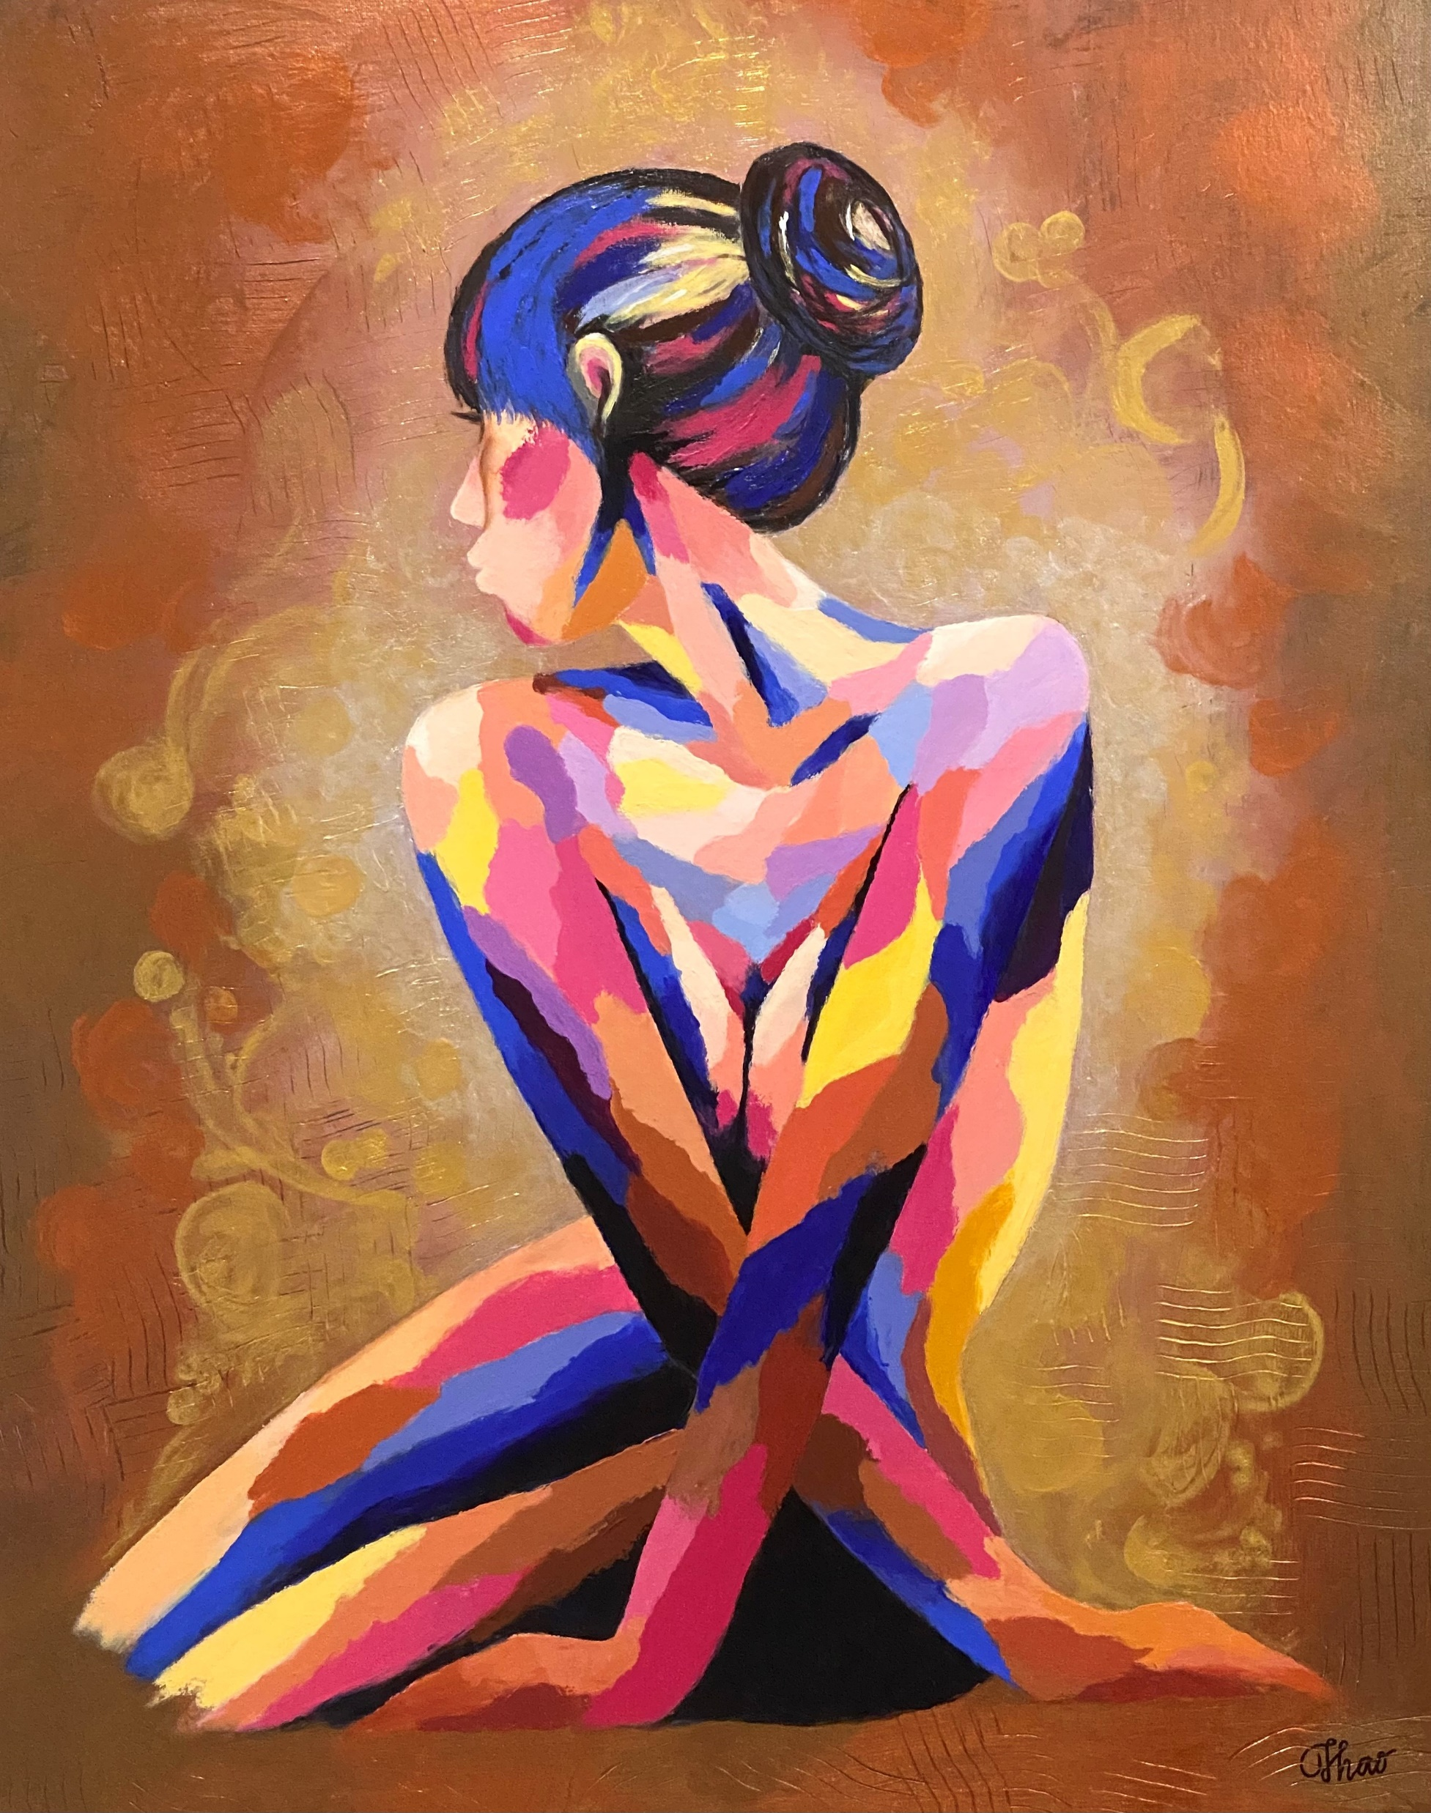
Women Figure #7– Acrylic on stretched canvas
Size: 60x76x3cm
Gloss varnish
AU$420.00
Add all the text description for this art piece as above
Photo for this page is #7
ThaoTruong Art - Joyful Art Getaway
*For display purpose only and may not be to scale

